Slide 1
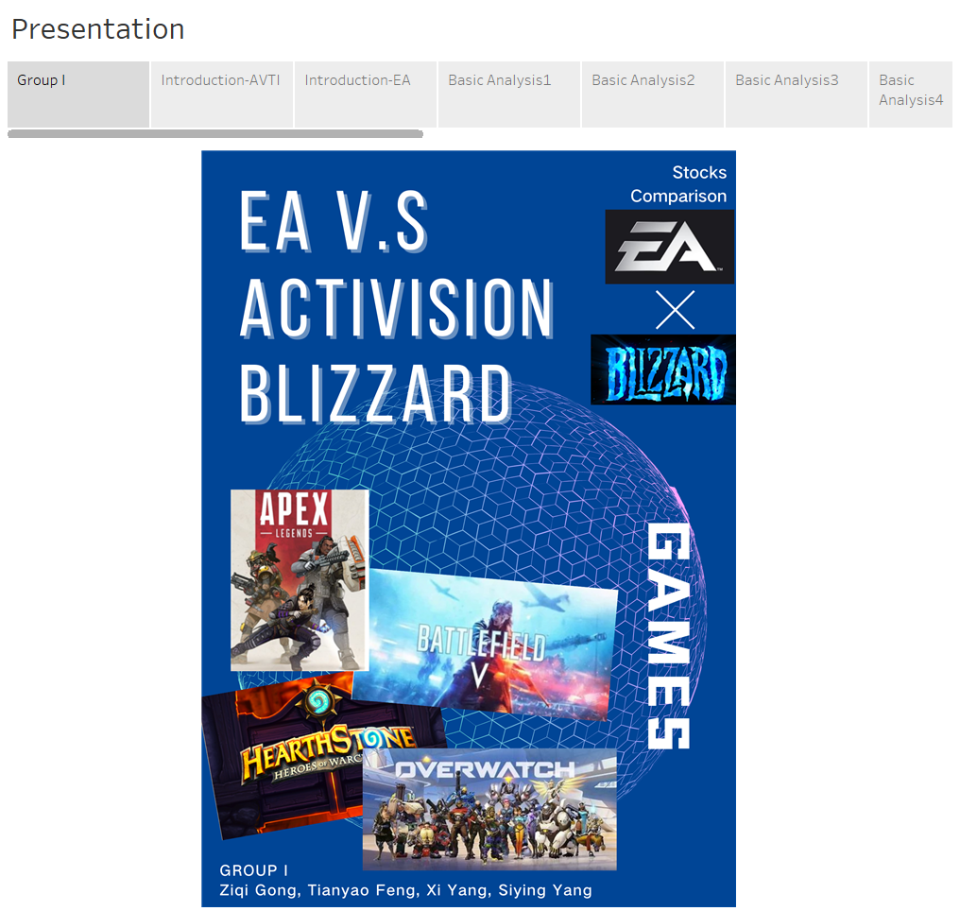
“
Stocks Comparison
EA VS ACTIVISION BLIZZARD
Ziqi Gong / Tianyao Feng / Siying Yang / Xi Yang
”
Group I

Slide 2
PART 01.
Source and Manipulation
Introduction about the two companys
and basic analysis in Tableau

Slide 3
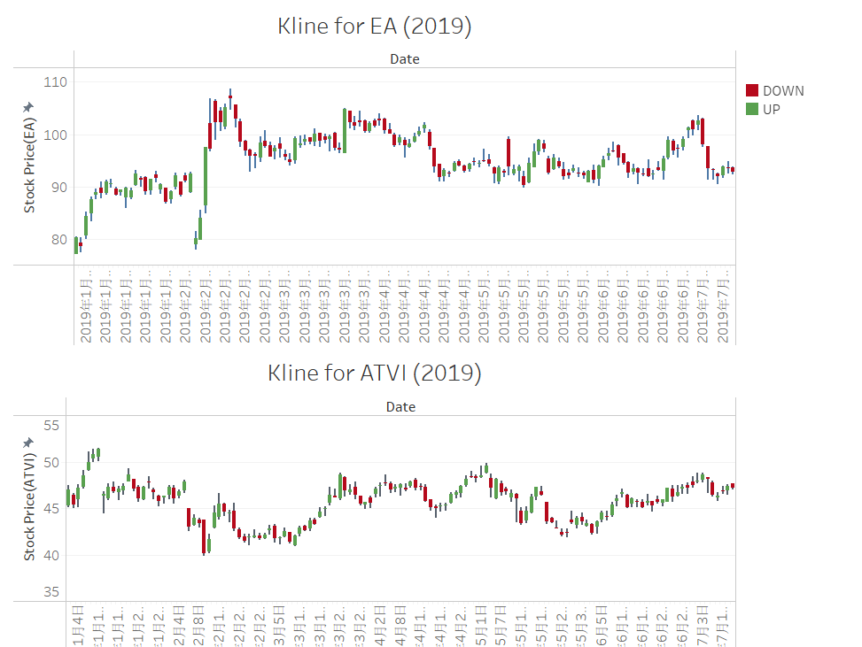


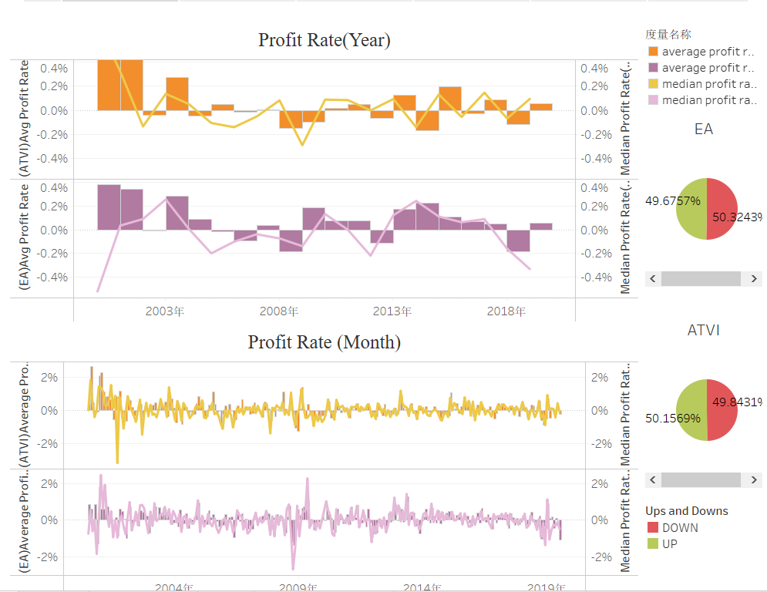
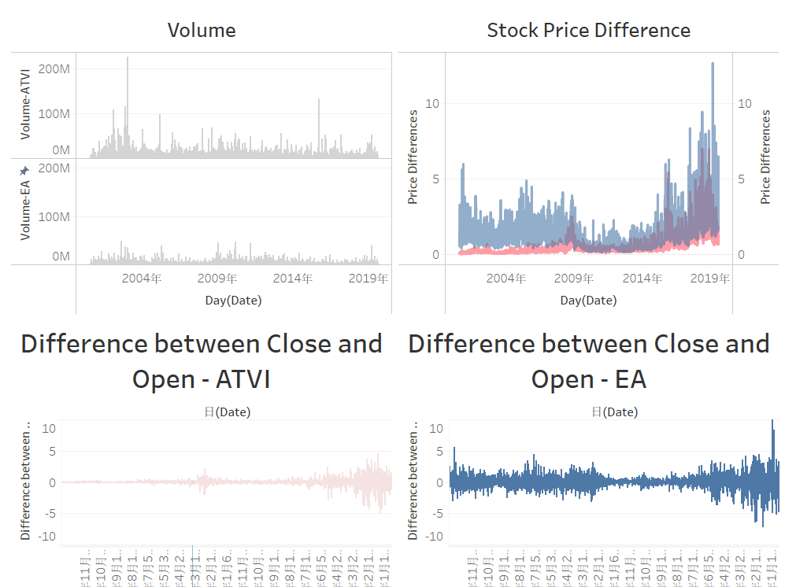
Source and Manipulation
PART ONE
Data Source
Kline
Basic Analysis
EA
ATVI
Less funds
more fluctuation
more activity
Better profitability
Bigger funds
less fluctuation
less activity
Less profitability

Slide 4
PART 02.
KPIs in Tableau
Introduction about two KPI: MA & BBI

Slide 5
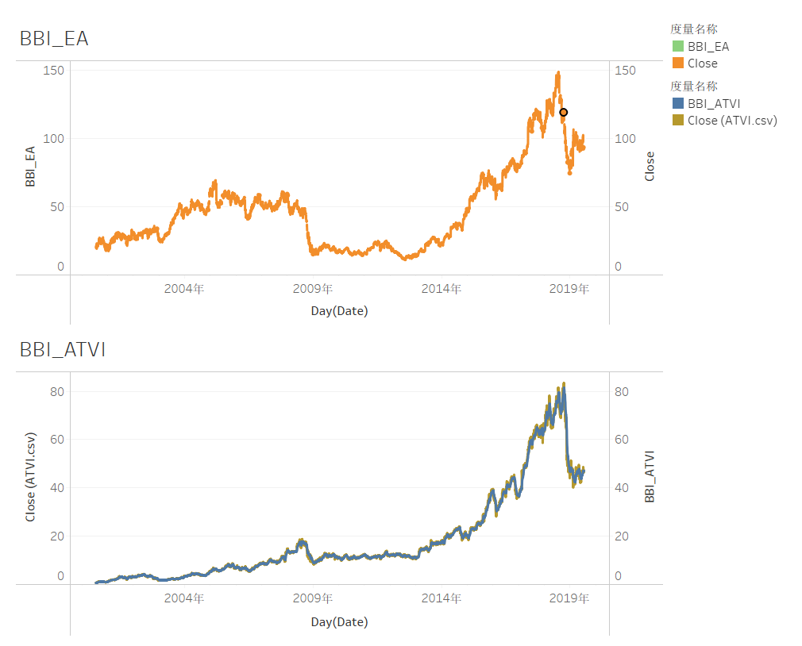
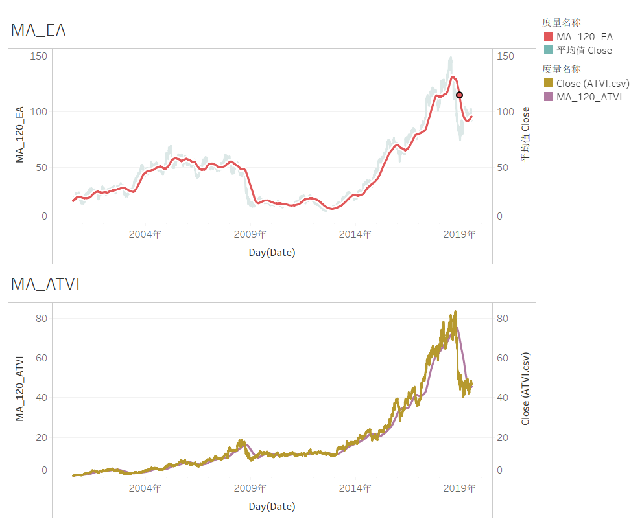
KPIs
PART TWO
KPI - BBI EA shows the descending trend, while ATVI has a short-term investment chance.
KPI- MA
The situation in ATVI is not quite positive for its downward trend.

Slide 6
PART 03.
Forecast Models in Python
Moving Average Method/ Simple Linear Regression /Multiple Regression/ Regression for Volume / Light GBM .

Slide 7
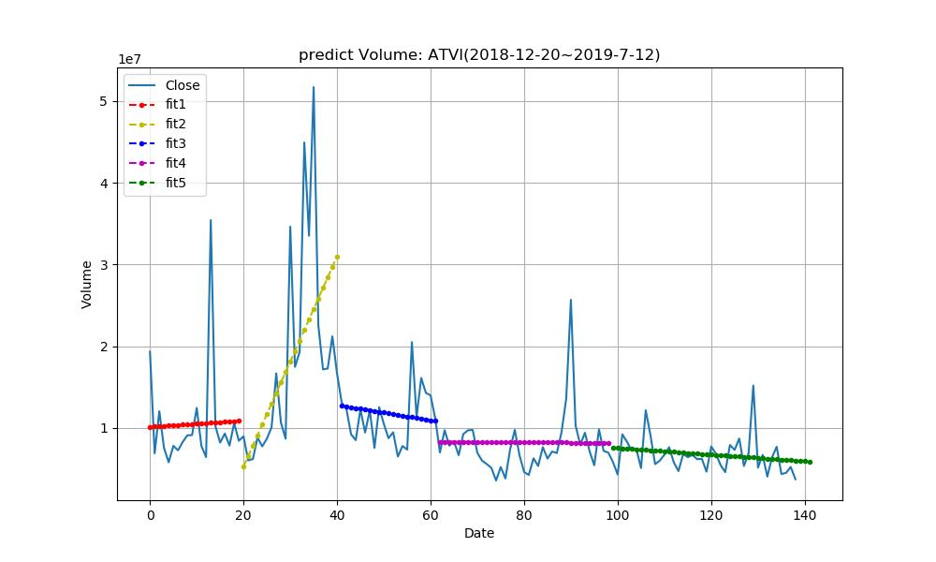
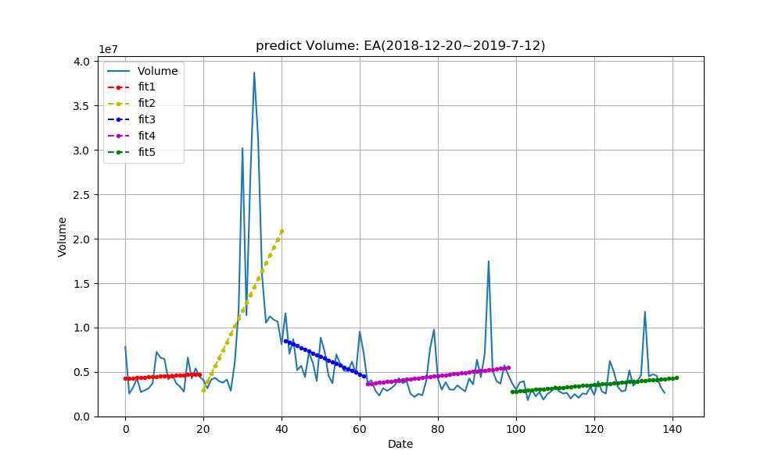
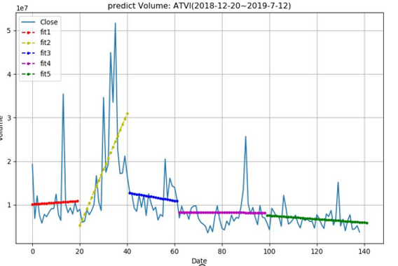
Forecast Models in Python
Regression for volume
PART THREE
EA
ATVI
ATVI: Volume=-40600*Date+11596994.8
EA: Volume=36595.96*Date-826041

Slide 8
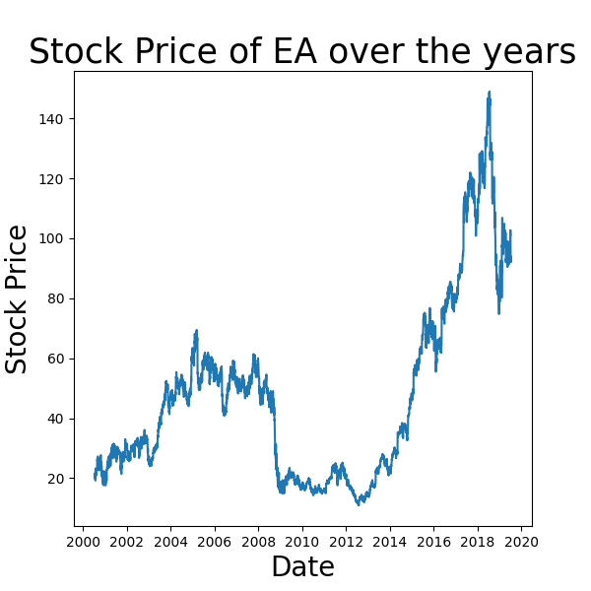
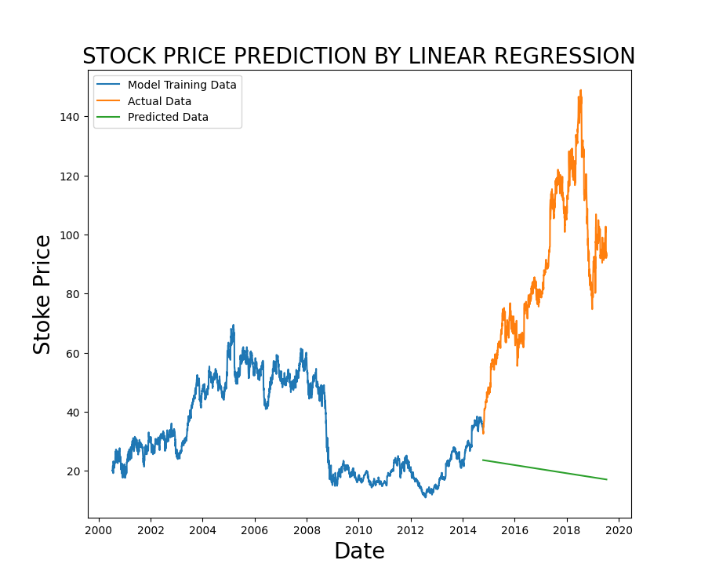
Forecast Models in Python-Basic Regression
PART THREE
Simple Linear Regression (EA)

Slide 9
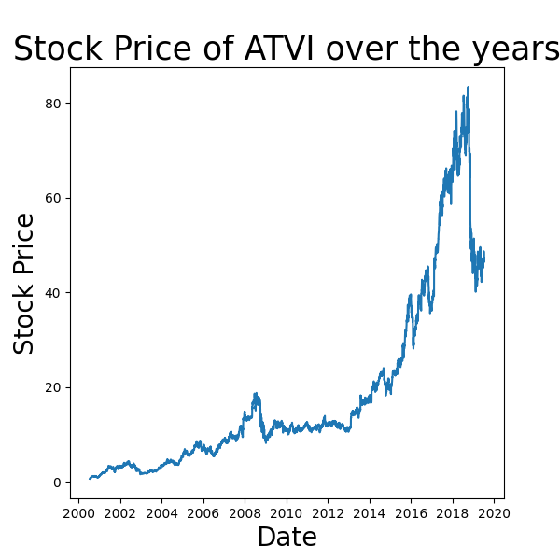
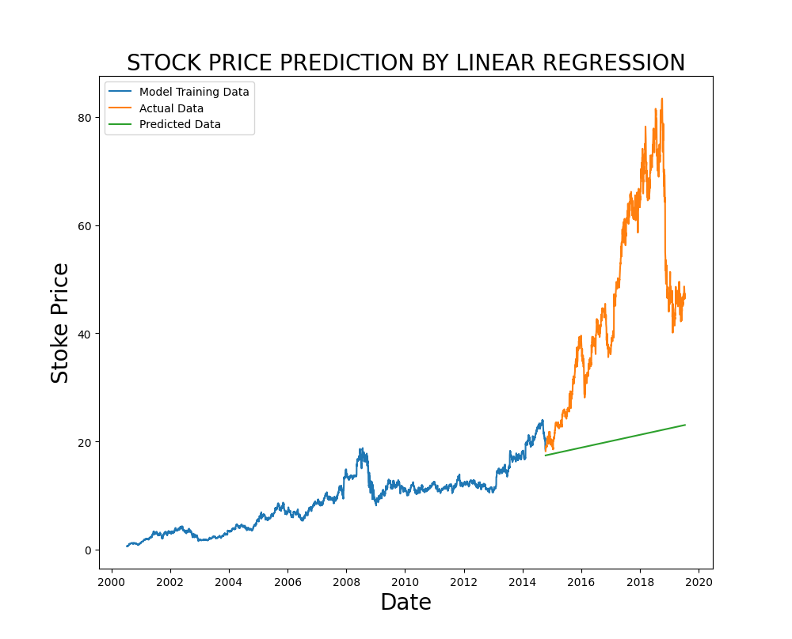
Forecast Models in Python-Basic Regression
PART THREE
Simple Linear Regression (ATVI)

Slide 10
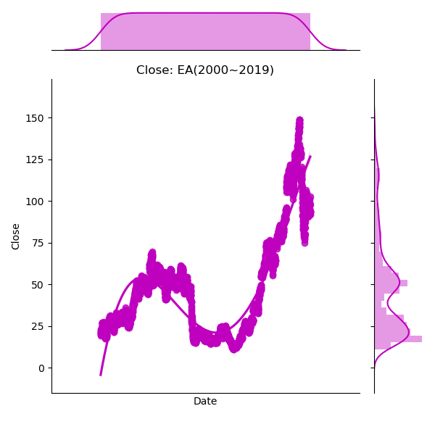
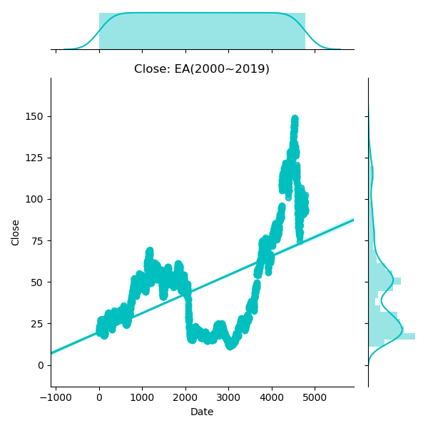
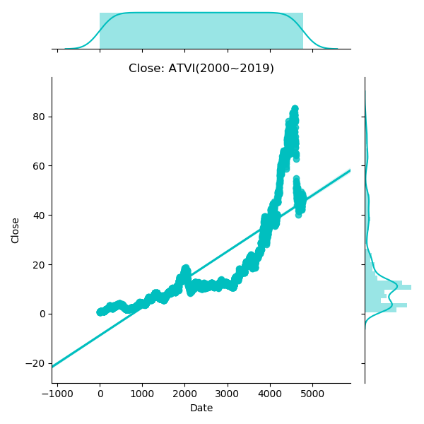
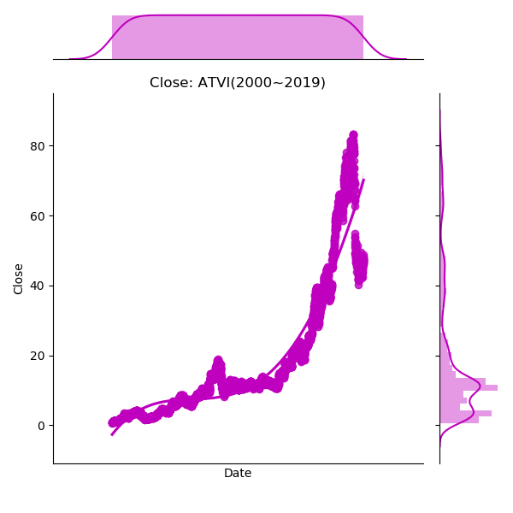
Forecast Models in Python-Basic Regression
PART THREE
Regression for Close(2000-2019）
Regression of
4 Orders
√ Better Fit
Linear Regression
√General Growing Trend

Slide 11
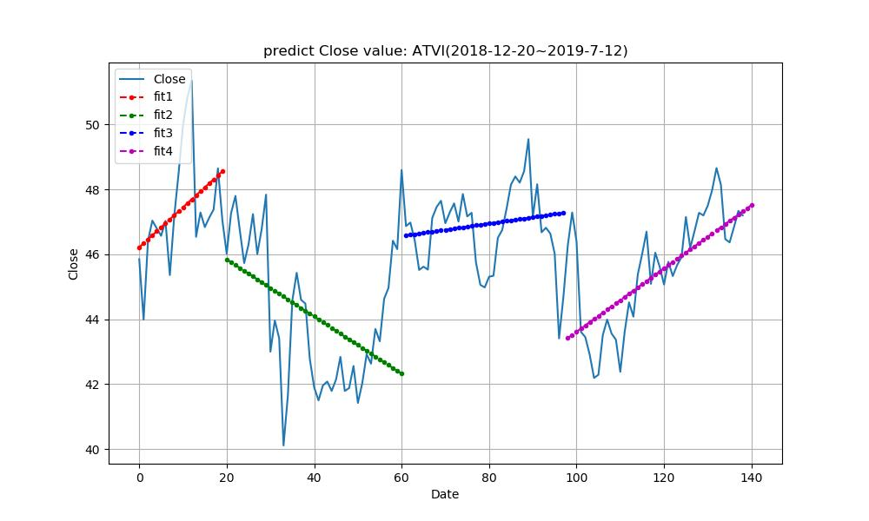
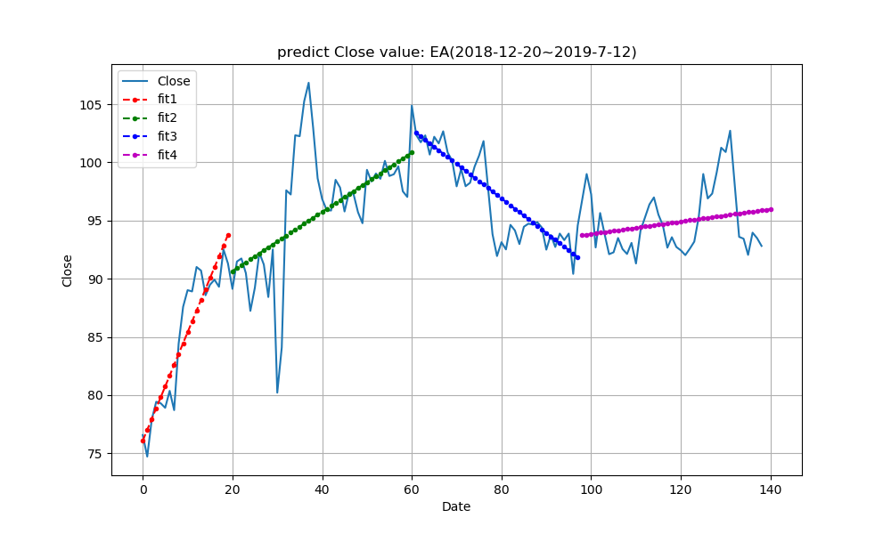
Forecast Models in Python-Basic Regression
PART THREE
Linear Regression
for Close
(2018.12-2019.7)
EA: Close=0.0546*Date+88.492
ATVI: Close=0.975*Date+33.862

Slide 12
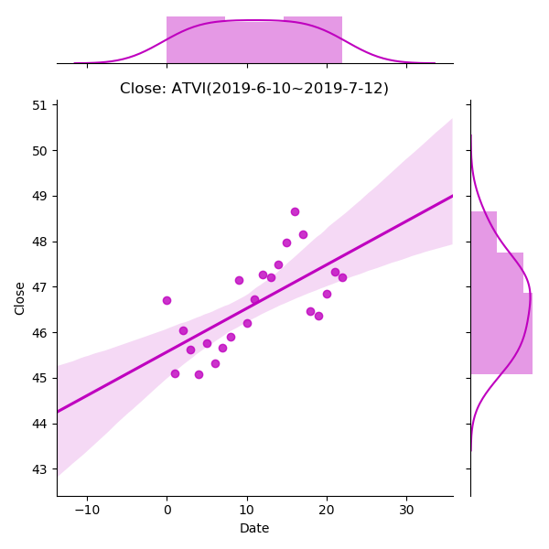
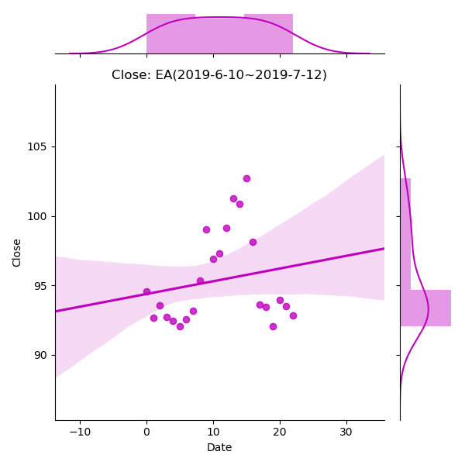
Forecast Models in Python-Basic Regression
PART THREE
Regression for Close( most recent month)
EA
ATVI

Slide 13
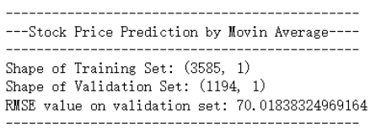
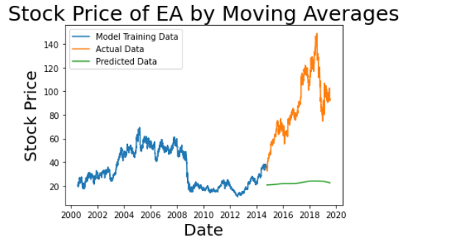
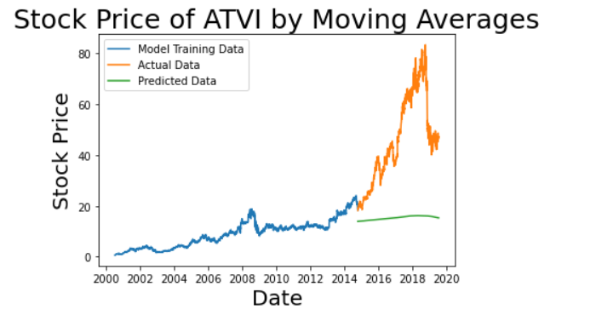
Forecast Models in Python-Advanced Prediction
PART THREE
Moving Average Method

Slide 14
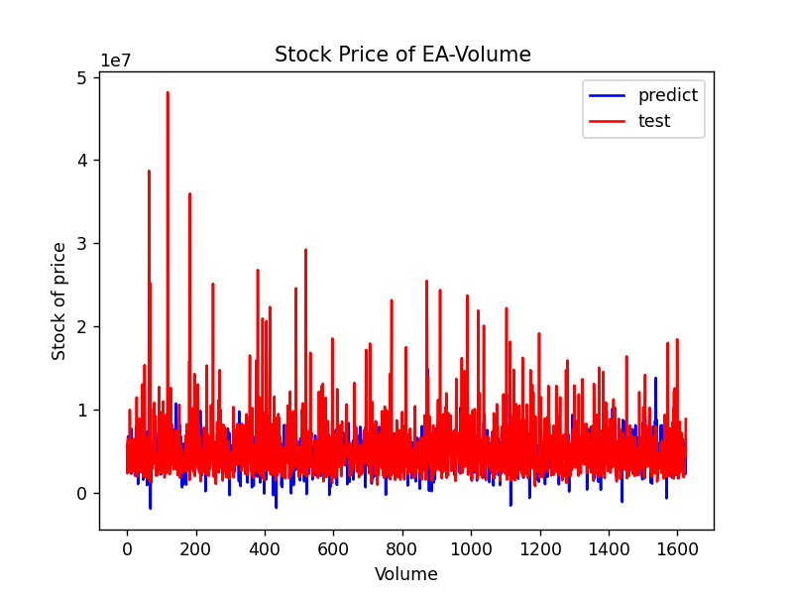
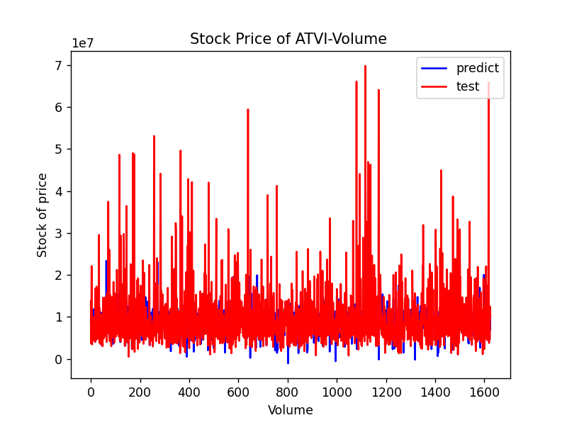
Forecast Models in Python-Advanced Prediction
PART THREE
Multiple
Regression

Slide 15
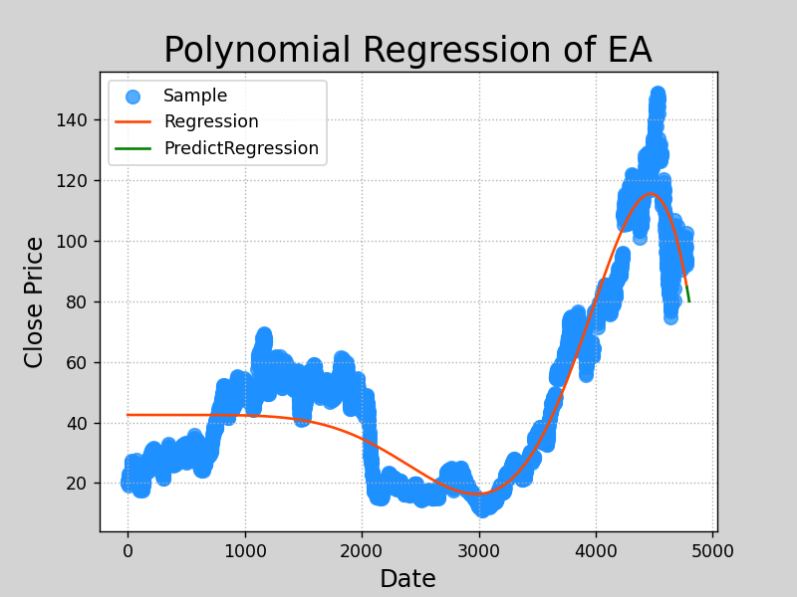
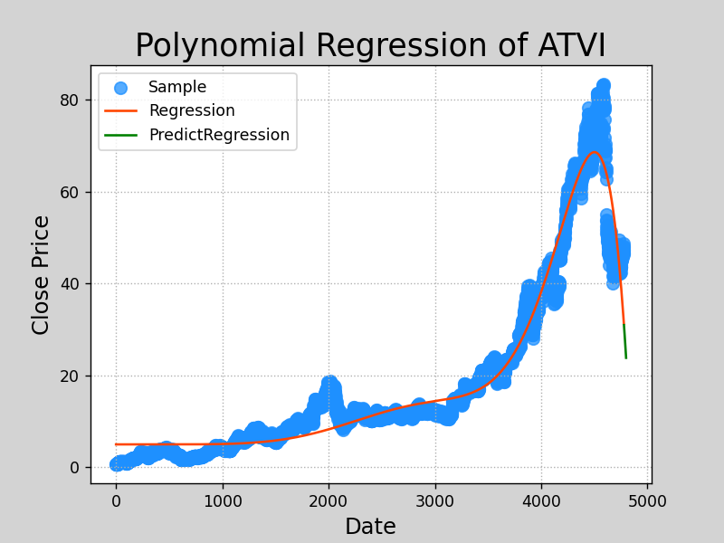
Forecast Models in Python-Advanced Prediction
PART THREE
Polynomial
Regression

Slide 16
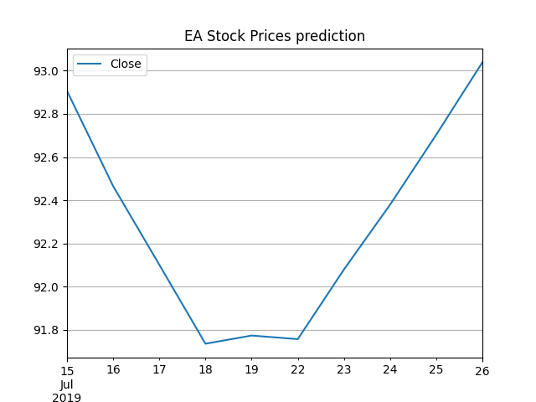
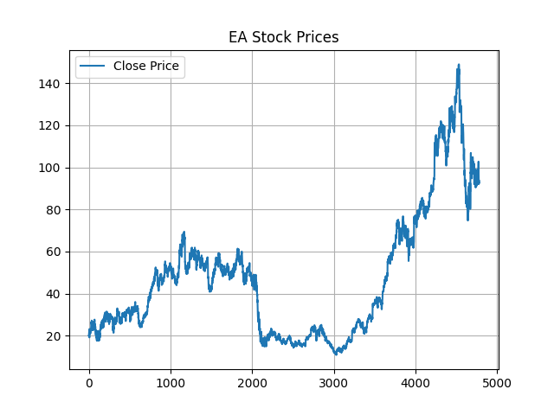
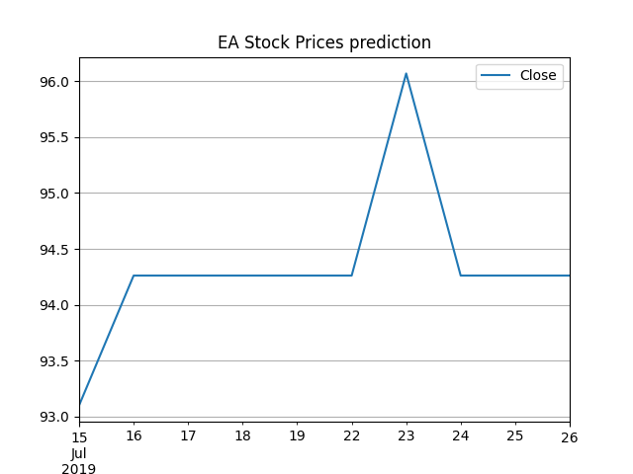
Forecast Models in Python-Advanced Prediction
PART THREE
AutoTS Prediction(EA)

Slide 17
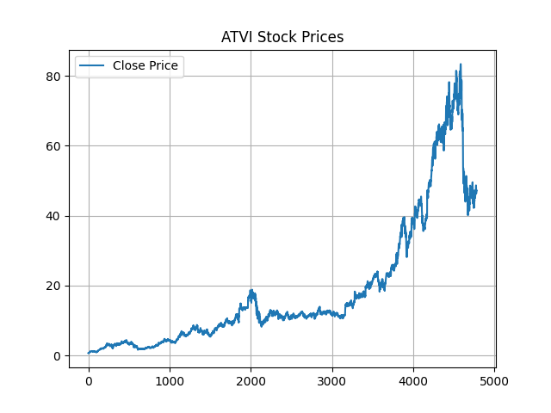
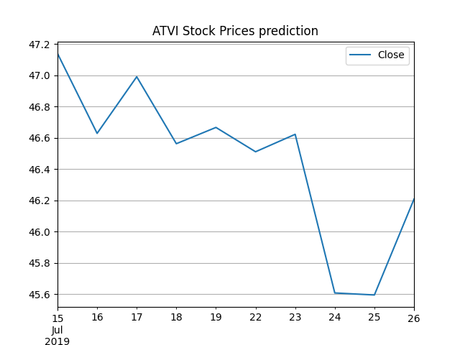
Forecast Models in Python-Advanced Prediction
PART THREE
AutoTS Prediction(ATVI)

Slide 18
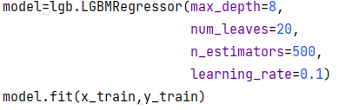
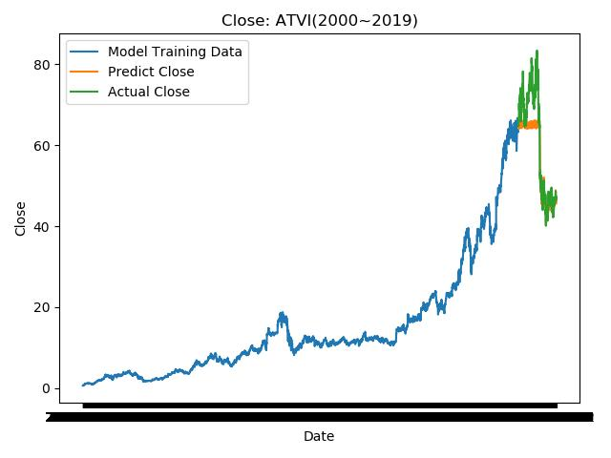
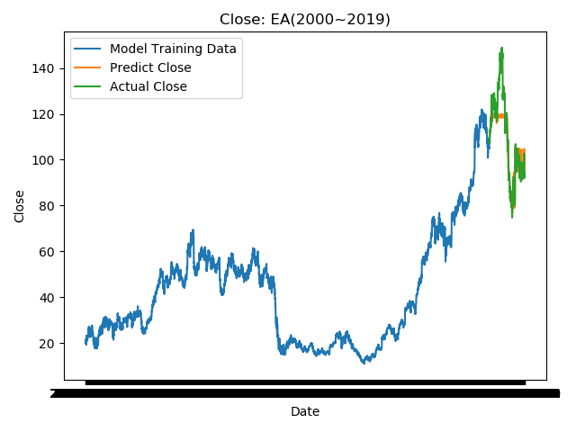
Forecast Models in Python-Advanced Prediction
PART THREE
LightGBM
LightGBM：MSE=0.21
√Outstanding Accuracy！

Slide 19
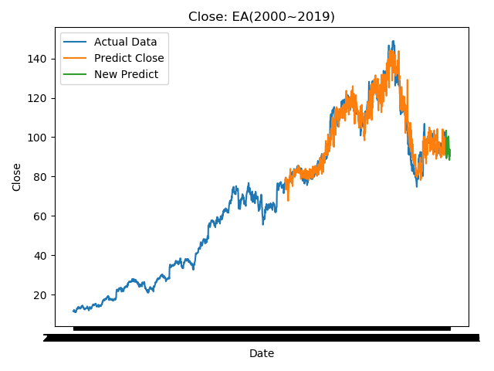
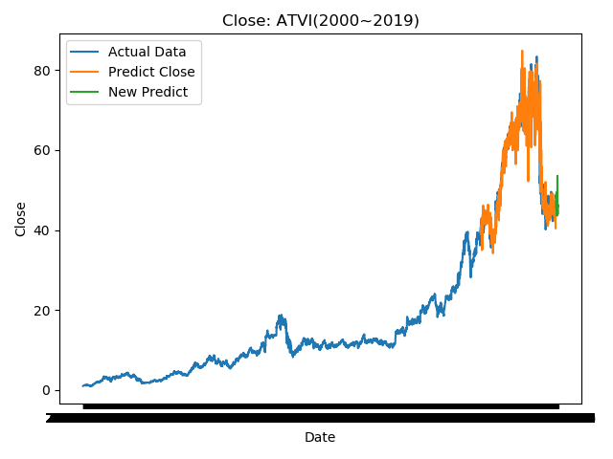
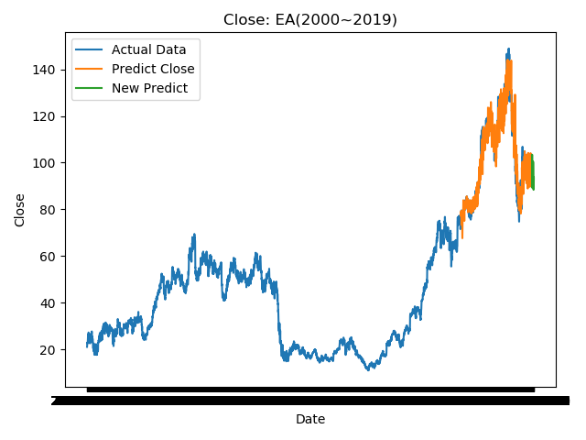
Forecast Models in Python-Advanced Prediction
PART THREE
LightGBM
ATVI
EA

Slide 20
Forecast Models in Python
PART THREE
Linear Regression
Basic Regression
4-Orders Regression
Predict-Close
Moving Average Methods
Multiple Regression
Further Prediction
Polynomial Regression
Auto TS
LightGBM

Slide 21
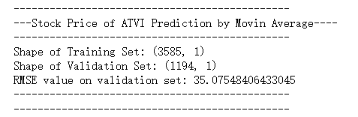
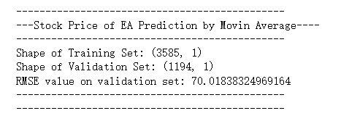

Conclusion
PART Four
WE Recommend:
ATVI
ATVI
Accuracy
ATVI has a more accurate outcome.
EA is more complex to predict.
EA
Long Term
Both have an upward trend.
But ATVI will go up more.
Short Term
ATVI has an upward trend
EA has an down trend
ATVI: Close=0.975*Date+33.862
EA: Close=0.0546*Date+88.492
=> ATVI has a higher slope

Slide 22
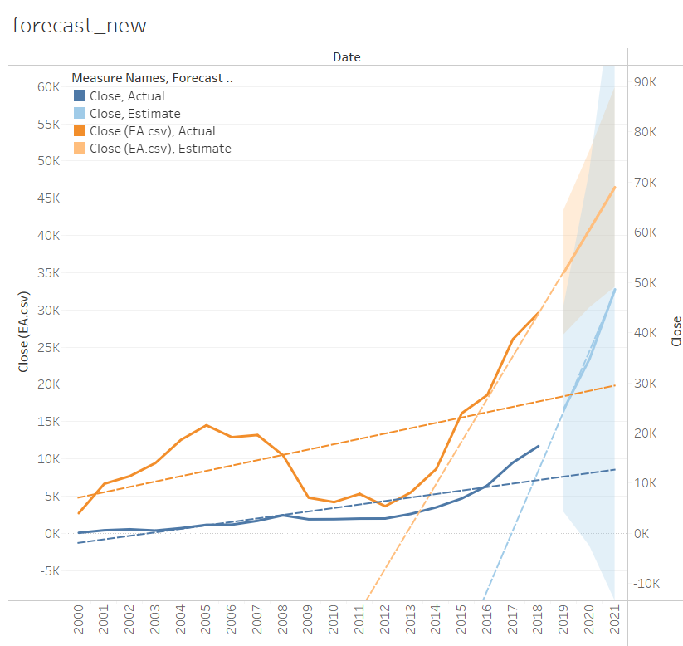
Conclusion
PART Four
Tableau
Focus more on descriptive analysis；
Very simple but inaccurate；
more accurate conclusion
have various choices of packages and models
evaluation index
Pycharm
Tableau is more suitable for data visualization
PyCharm is a better choice for complex data analysis and fulfill the high desire of precision
Forecast in Tableau

Slide 23

THANK YOU!
❤
Group I

